Slide 1

AI Personal Investment Advisor
Intelligent Wealth Management Powered by GenAI & Real-Time Market Agents

Slide 2
The Vision: Automating Financial Intelligence
Bridging the gap between complex market data and personalized human goals.

Slide 3

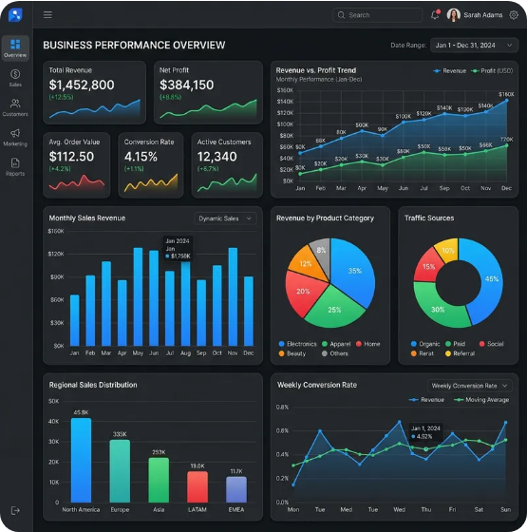
Personalized Advisory Engine
•
Dynamic User Profiling: Advice adjusted for risk appetite, income, and specific financial milestones.
•
Real-Time Insights: Integrated agents fetch live indices for S&P 500, Nasdaq, and Crypto.
•
High-Speed Synthesis: Utilizing Groq-powered Llama 3 for near-instant portfolio generation.

Slide 4





Core Technical Framework
Expert Prompting
Agentic Logic
Sophisticated prompt engineering defines the financial expert persona for high-fidelity reasoning.
Autonomous tools (yFinance) bridge the gap between LLM static training and live market volatility.
Responsible AI
Rapid UI
Automated compliance disclaimers ensure safe and ethical financial recommendations.
Built with Streamlit for a responsive, interactive experience from day one.

Slide 5
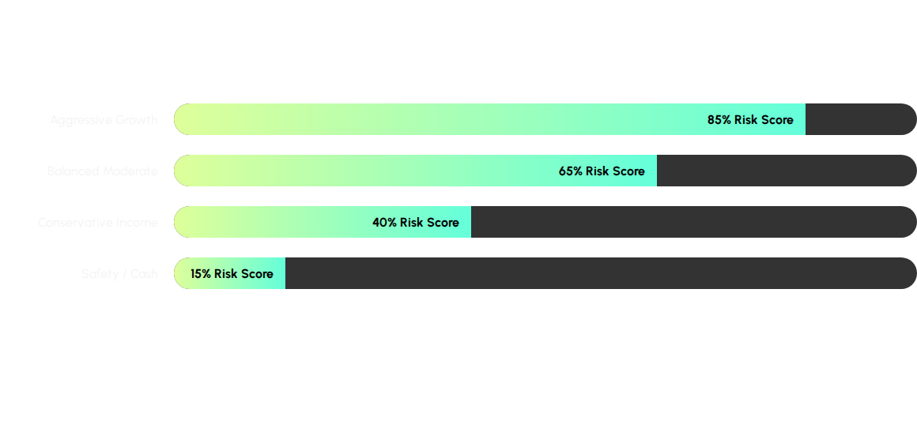
Portfolio Risk Simulation
Our engine maps user risk profiles directly to simulated volatility indices.

Slide 6

Next-Gen "What-If" Analysis
Stress-test your financial future. Users can instantly simulate market crashes or bull runs to see real-time portfolio adjustments.
•
Scenario-based logic testing
•
Instant feedback loops
•
Goal viability tracking

Slide 7
Any Questions?
AI Personal Investment Advisor • GenAI Challenge 2024
Demo Ready: Localhost Deployment Successful
Engine: Python / Streamlit / Groq / yFinance

Slide 8


Image Sources
https://media.easy-peasy.ai/ce6b6505-9bab-4961-8bb8-990c99420b82/f1df071b-7f8e-41d1-80f4-90d2d9036320_medium.webp
Source: easy-peasy.ai
https://media.istockphoto.com/id/880896732/vector/stock-market-revenue-graph-vector-illustration-green-numbers-column-uptrend-lines-trading.jpg?s=612x612&w=0&k=20&c=pyCyAip2wS-YTnSS02o33JqLPZRUq_1YQDRzfyZtkE4=
Source: www.istockphoto.com

